Slide 1




Qualities of a good teacher
Qualities of a good Teacher

Slide 2
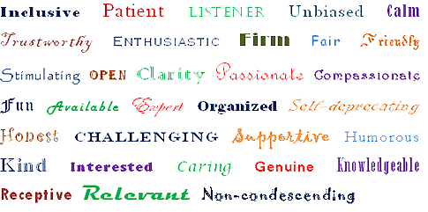
What qualities do you think a good teacher should have?
Qualities of a good Teacher

Slide 3
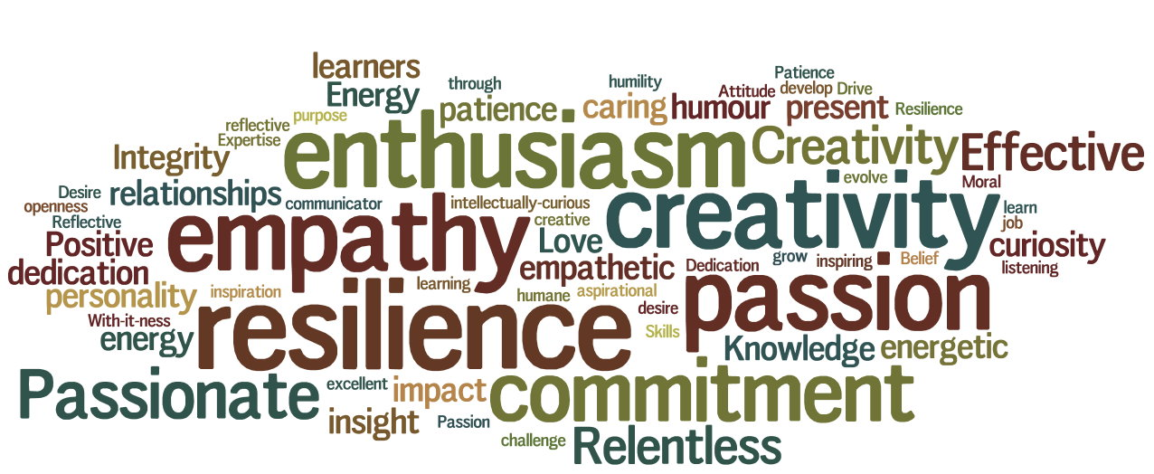
What good qualities do you remember from your teachers?
Qualities of a good Teacher

Slide 4
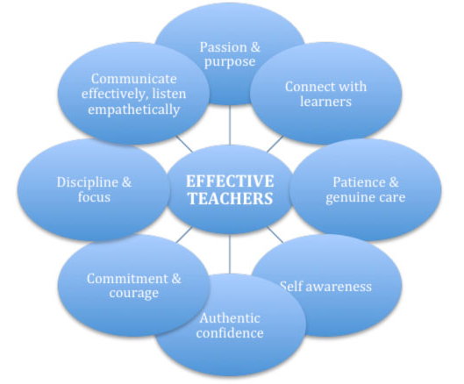
Which teachers were your favourite and why?
Which teachers were your least favourite and why?
Qualities of a good Teacher

Slide 5
Qualities that Allah loves
Manners and Characteristics of Our Beloved Prophet (SAW)
Qualities of a good Teacher

Slide 6
فَبِمَا رَحْمَةٍ مِّنَ اللَّهِ لِنتَ لَهُمْ ۖ وَلَوْ كُنتَ فَظًّا غَلِيظَ الْقَلْبِ لَانفَضُّوا مِنْ حَوْلِكَ ۖ فَاعْفُ عَنْهُمْ وَاسْتَغْفِرْ لَهُمْ وَشَاوِرْهُمْ فِي الْأَمْرِ ۖ فَإِذَا عَزَمْتَ فَتَوَكَّلْ عَلَى اللَّهِ ۚ إِنَّ اللَّهَ يُحِبُّ الْمُتَوَكِّلِينَ
Qualities of a good Teacher

Slide 7
And by the Mercy of Allah, you dealt with them gently. And had you been severe and harsh-hearted, they would have broken away from about you; so pass over (their faults), and ask (Allah's) Forgiveness for them; and consult them in the affairs. Then when you have taken a decision, put your trust in Allah, certainly, Allah loves those who put their trust (in Him)
Qualities of a good Teacher

Slide 8

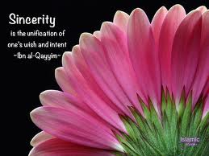


1. Sound Intellect
2. Doing things for the sake of Allah
3. Sincerity
4. Good Morals, Ethics and Companionships
5. Politeness and Good Manners
6. Love for Reformation and Reconciliation
7. Ordering with the good and forbidding evil
8. Love of Purification
Qualities of a good Teacher
Notes:
The messenger of Allah SAW had an excellent, complete and sound intellect. No man has ever had an intellect as complete and perfect as his.
7. Abdullah bin Abbas RA said The messenger of Allah (SAW) saw a man wearing a gold ring, so he reached for it, removed it and threw it. He then said “Would one of you seek a burning charcoal and place it on his hand?” The man was later told, after the Prophet SAW left: “Take your ring! Make good use of it {by selling it}.” The man said, “ No! by Allah I will never take it after the Prophet SAW said threw it away. MUSLIM # 2090

Slide 9



9. Safeguarding and Minding One’s Language
10. Excelling in Acts of Worship
11. Forbearance and Kindness
12. Good Appearance
13. Asceticism in Worldly Affairs
14. Altruism
15. Strong Faith and Dependence on Allah
16. Kindness and Compassion
Qualities of a good Teacher
Notes:
13. Abdullah bin Masood, with whom Allah be pleased said:
“The messenger of Allah SAW went to sleep on a mat. When he got up and he had marks on his side due to the mat that he slept on. We said: “O messenger of Allah, shall we not make bedding for you?” He said: “ What do I have to do with this world? I am only like a wayfarer who rides a beast that stooped to take shade and rest under a tree, and then leaves behind and continues on the journey.”

Slide 10


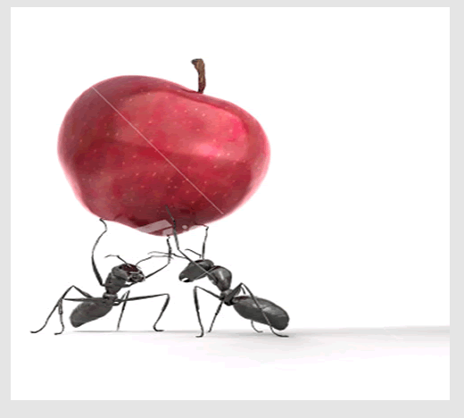

17. Simplification and Ease
18. Fearing Allah, being Mindful to not trespass
His Limits and Devotion
19. Expending Generously
20. Cooperation
21. Truthfulness
22. Aggrandizing the limits and boundaries of
Allah
Qualities of a good Teacher
Notes:
19. Anas bin Malik RA
“The messenger of Allah (SAW) was never asked for something when someone accepted Islam, except that he granted that person what he asked. A man came to the Prophet (SAW) and he gave him a herd of sheep that was grazing between two mountains. The man returned to his people and said: “O my people accept Islam! Muhammad SAW gives out generously like one who does not fear poverty.” MUSLIM # 2312
22. A”isha with who Allah is pleased said
“The Prophet (SAW) was not given a choice between two matters, except that he chose the easier between the two, as long as it was not a sinful act. If that act was a sinful act, he would be the farthest from it. By Allah! He never avenged himself. He only became angry when people transgressed the limits and boundaries of Allah, in that case he avenged.

Slide 11


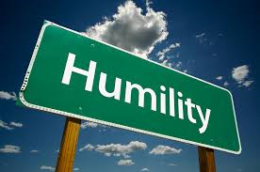
23. Pleasant Facial Expression
24. Honesty and Loyalty
25. Bravery and Courage
26. Generosity and Hospitality
27. Bashfulness and Modesty
28. Humbleness
29. Mercy and Compassion
Qualities of a good Teacher

Slide 12

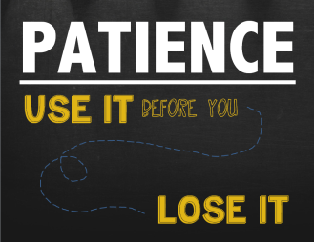
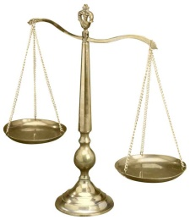


30. Perseverance and Forgiveness
31. Patience
32. Justice and Fairness
33. Fearing Allah and Being Mindful of Him
34. Satisfaction and Richness of the Heart
35. Hoping for Goodness Even for his Enemies
Qualities of a good Teacher

Slide 13

Points to consider for an effective lesson
Hardworking
You don’t have to be intelligent to be a good teacher.
Plan
Planning your lesson is of utmost importance
Prepare
Be thoroughly prepared for your lesson.
Qualities of a good Teacher

Slide 14

Points to consider for an effective lesson
Language
Clear
Understandable
Teaching Aids
Has a greater effect on the lesson
Presentation
Stand up and present your lesson.
Qualities of a good Teacher

Slide 15
Points to consider for an effective lesson
Delivery
Be enthusiastic!
Be child conscious!
Conduct according to child’s ability!
Learner
The learner is the best aid that you can use.
Qualities of a good Teacher

