Slide 1




Discipline
Discipline

Slide 2

When you think of Discipline…
What are the first thoughts the come to mind?
Jot down a few points and hold onto them! We’ll get back to it later!
Whenever you see this notepad, get your pens and your minds working!
Discipline

Slide 3
Teaching of Discipline
Good order is the classroom’s first law.
The Muallim/a teaches discipline just as much as he/she teaches other subjects.
Number of debates on correct way to discipline learners.
Learners expect to learn discipline. They need/want rules by which to live in order to live harmoniously together.
Discipline

Slide 4
They learn best in a classroom in which there are rules to follow.
Self discipline then is our aim and, as institutions, we are expected to teach it.
Precisely, the same as in teaching any subject matter, mere telling/lecturing is not enough.
What works for one learner fails with another.
Discipline

Slide 5

Discipline, like any other subject, needs creative ideas in order to be taught effectively to learners.
What are your thoughts on the importance of discipline?
Make some notes and let’s discuss!
Discipline

Slide 6
What is the major difficulty that you have in dealing with children?
How should a young muallim/a deal with undisciplined learners?
So that they do not disrupt the class and disturb those eager to learn?
Without discipline there can be very little of meaningful learning.
Discipline

Slide 7
Contemplate over the following scenarios:
Mohammed usually completes his work before everyone else and then disrupts the class.
Because Yusuf is such an energetic child he constantly needs to keep busy. When he has nothing to do, he starts misbehaving.
Let’s discuss these problems.
How can they be solved?
Discipline

Slide 8
Preventive Discipline
Preventive measures will put a stop to most forms of normal misbehavior.
Children should be kept busy with worthwhile work
If every learner has something purposeful to do, there will be fewer cases of misbehavior.
Extra work should be made available to pupils who are complete with their work.
Discipline
Notes:
Preventive measures will put a stop to most forms of normal misbehavior.
Since most children are very energetic, a Muallim should keep learners busy all the time at worthwhile work.
If every learner has something purposeful to do, there will be fewer cases of misbehavior.
Extra work, provided it can be done without disturbing others, should be made available to pupils who are complete with their work.

Slide 9
Contemplate over the following scenario:
Muallima Ayesha’s classroom is cramped, stuffy and dusty. Her learners tend to get restless quickly and are unmotivated by the unwelcoming environment.
What suggestions can we give?
How important is the learning environment?
Discipline

Slide 10
Not all physical discomforts can be avoided.
Try different methods to make the learners more comfortable.
Try a variety of methods and ways to stimulate and challenge the pupils.
Discipline
Notes:
Not all physical discomforts can be avoided.
The Muallim/a could reseat pupils making them more comfortable’ ventilate the classroom, send learners who are ill home, and stop learners from injuring and teasing others.
Try a variety of methods and ways to stimulate and challenge the pupils.

Slide 11
Contemplate over the following scenario:
Zaheer would often interrupt the classroom and lacked motivation to excel. Muallim Yaseen, instead of scolding him, began giving Zaheer some responsibilities in class. He also began forging a relationship of mutual trust.
Do you think Muallim Yaseen suceeded in changing Zaheer’s attitude? What do you think the results were, and why?
Discipline

Slide 12
Learners could be given responsibilities in class.
The Muallim/a should accept apologies and promises.
The Muallim/a should display an attitude of trust.
Discipline
Notes:
Learners could be given responsibilities in class, e.g. opening windows, distributing notes, turning on and off lights, cleaning the board etc.
The Muallim/a should accept apologies and promises and give evidence that promises are kept.
The Muallim/a should display an attitude of trust, for learners will react favorably to a belief in their abilities and worth.

Slide 13
Setting up a good learning environment
In this section we hope to provide tools to improve the learning environment .
It will be advantageous to all if the Madrassah/School sets the correct tone and sets up healthy relationships between all parties.
Remember that disruptive behavior from a learner can be a cry for help.
Discipline
Notes:
If the Madrassah/School sets the correct tone and encourages the development of a healthy relationship between Mu’allim/Learner it will be to the advantage of all concerned.
Disruptive behavior from a learner can be a cry for help. The Mu’allim/ah can turn these events into opportunities of influencing the child for life. Sometimes, we let slip these challenges, and the moment is lost forever.

Slide 14
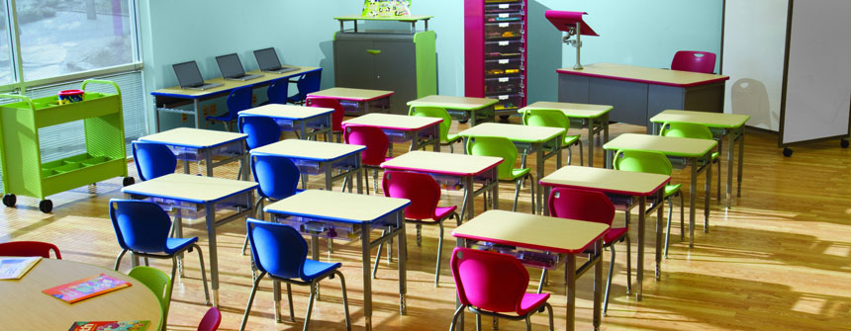
Setting up a good learning environment
Seating Arrangements
Which seating arrangement do you employ
in your classroom?
Discipline

Slide 15
Contemplate over the following scenarios:
Muallima Asma finds that some learners sit on their own and do not get involved in classroom discussions. How can she change her classroom setup in order to solve these problems?
Muallim Mohammed can not keep his eyes on all of his learners at all times. Due to this certain children are becoming disruptive and the classroom is becoming unruly. How can he arrange his classroom in order to try and solve this problem?
Discipline

Slide 16
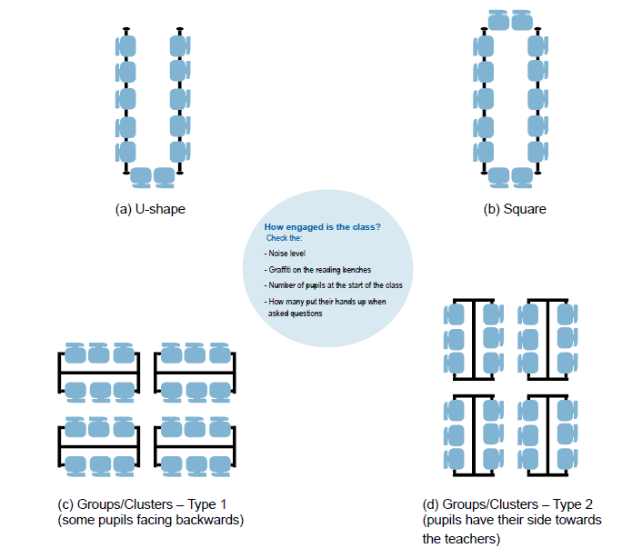
Let us look at these pictures and consider the various options.
In your own experiences, what seating plan do you prefer?
Discipline

Slide 17
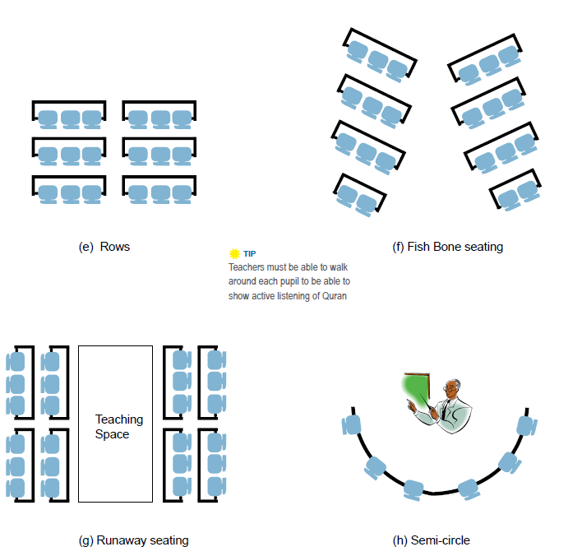
Discipline

Slide 18
Now lets go through each different seating plan.
In your own notes, draw a simple table like the one below:
 | U shape | Rows | Group/clusters | Square
Advantages
Disadvantages
Lets fill it in together by discussing the various points.
Discipline

Slide 19
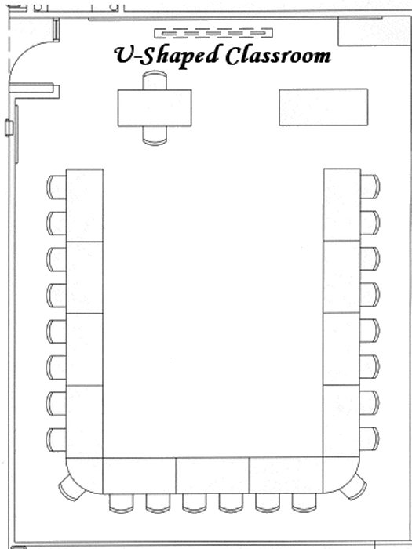
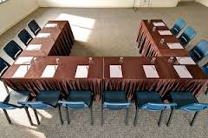
Classroom Setup: U Shape
Disadvantages
Advantages
Not good for team/ group work
Eye contact with teacher
Teacher can see all pupils
Pupils sitting in front ends will be facing the board at an angle.
Teacher can get around classroom and all pupils.
Can be disruptive as pupils will try to talk to others across the room.
Discipline

Slide 20
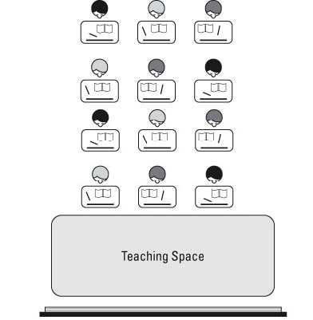
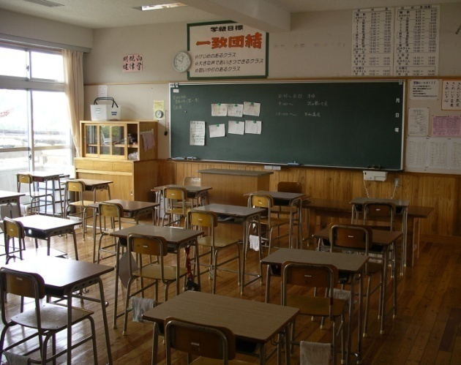
Classroom Setup: Rows
Advantages
Disadvantages
Eye contact with teacher
Not good for teamwork or discussion because pupils have their back to others.
Teacher can see all pupils
Easy for pupils at the back to lose concentration and not participate in lessons.
Teacher can get around classroom and all pupils.
Less distraction. Improves their attention to work when working on their own.
Whole class discussions are difficult because some pupils will have their back to others.
Discipline

Slide 21
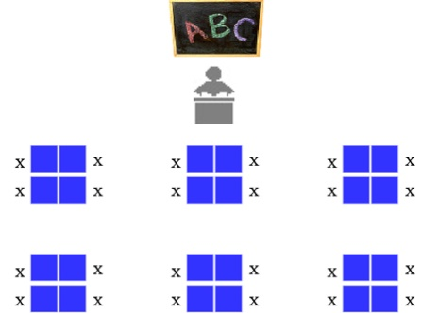
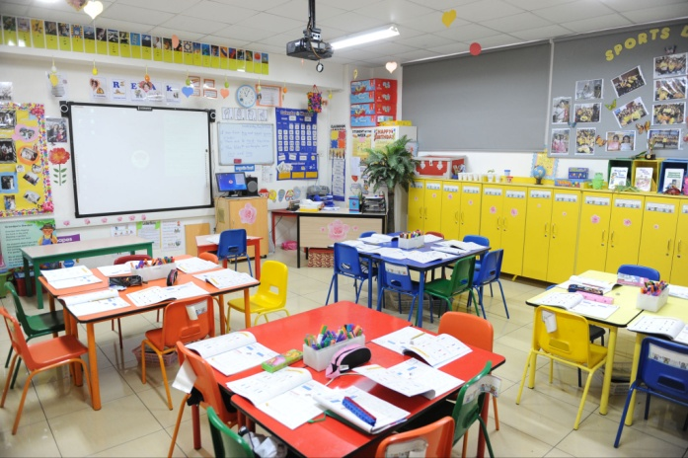
Classroom Setup: Groups/ Clusters
Advantages
Good for teamwork requiring collaboration as pupils can see each other.
Disadvantages
Teacher can get around classroom and amongst all pupils.
Some pupils will have their backs to teachers making it difficult to take notes.
Harder to concentrate for individuals.
Waste time on frivolous chatting.
Whole class discussions are difficult as pupils are sitting in small groups.
Discipline

Slide 22
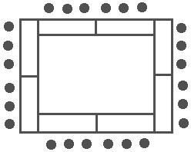
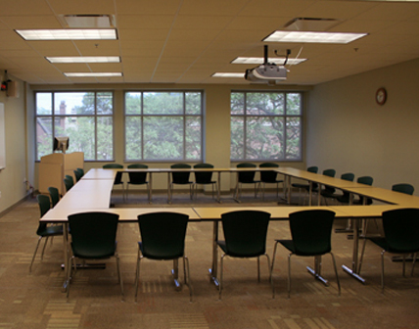
Classroom Setup: Square
Advantages
Disadvantages
Good for holding discussions and debates.
Encourages everyone to get involved
Eye contact between all pupils can be maintained
Some pupils will have their backs to teachers making it difficult to take notes.
Harder to concentrate for individuals.
Waste time on frivolous chatting.
Discipline

Slide 23

Let us stop, take a breather and consider the following:
Do you agree/ disagree with any of the points discussed this far? Jot them down for discussion.
Now lets continue by discussing what you can do to create a good learning environment.
Discipline

Slide 24



Creating an environment that is conducive to good learning
Model the learner’s behaviour- some learners don't know the difference.
Do not allow deviant behaviour to creep into the classroom- bullying, teasing, etc...
Give them responsibilities.
Discipline

Slide 25


Creating an environment that is conducive to good learning
Do not be stern and serious all the time. Remember these are young people.
Let them all have an opportunity of achieving success.
A classroom that is well managed will yield positive results in terms of discipline.
Discipline

Slide 26
Never say “Shh” or “Please be quiet class.”
Pick out offenders and call them by name.
Don’t turn your back to the class.
Speak distinctly and forcefully.
Never punish the whole class.
General
Tips
Discipline

Slide 27
Avoid setting up a “spy” system.
Make the punishment fit the circumstance.
Avoid loss of personal control.
Always calm yourself before administering punishment.
Never give madrassah work as punishment.
General
Tips
Discipline

Slide 28
Give an offender every opportunity to understand the reason for any punishment taken.
Never threaten punishment and then fail to carry it out.
Don’t humiliate a child either in public or private.
DO NOT use corporal punishment under any circumstances.
General
Tips
Discipline

Slide 29

Do you do any of the above?
If so, consider what effect it may have had in the past.
Can you, in your own experience, think of any other tips to avoid in the future?
Discipline

Slide 30
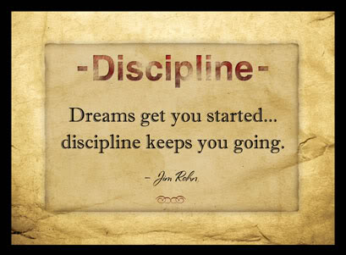
Discipline doesn’t need to be boring!
If you think about it, you can come up with creative ways to discipline your learners!
Discipline

Slide 31
Methods of Discipline
What are some of the ways in which you usually enforce discipline?
How effective are they? Are there any negative effects cause by your method of discipline?
Let us look at different ways in which discipline can be carried out.
Discipline

Slide 32
Methods of Discipline
1. Use actions to show disapproval of the learner’s behaviour.
2. Indicate what learner should do as a replacement for the disapproved activity.
3. Give a learner work which changes his lack of attention to active participation.
Discipline
Notes:
1. Use actions to show disapproval of the learner’s behaviour: shake your head, register surprise or an enquiring look, remove object of attention from learner.
2. Pass a learner a new note or point finger or nod head to indicate what learner should do as a replacement for the disapproved activity.
3.Give a learner work which changes his lack of attention to active participation.

Slide 33
Methods of Discipline
Zubair was disrupting the classroom. When his Muallim called him to help him write on the board, he could no longer instigate his friends and disrupt the class.
4. While demonstrating or making notes on the chalkboard, enlist the assistance of an inattentive or misbehaving learner.
Luqmaan and Zakariyya would often chat and play, thereby disrupting the whole class. When Muallima Ayesha separated the two, they were each much better behaved.
5. Re-seat the offender, move his friend to the opposite side or somehow isolate him so that he cannot further distract his classmates.
Discipline

Slide 34
Methods of Discipline
9. Let them know you’re watching before misbehavior begins.
8. Don’t give the “show-off” additional attention.
7. Let the learner remain after madrassah.
6. Remove the privilege which the learner has abused.
Discipline
Notes:
6.Remove temporarily from a learner the privilege which he has abused.
10. Firmly say “no” or “stop” to what is likely to become a more serious action.
8. Temporarily ignore the “show-off”, but later assign him/her productive classroom work.
7. Require a learner to remain after madrassah to finish the work not done.
9. Cast his/her eyes over the entire class every minute or so, to prevent misbehavior before the start.

Slide 35
Methods of Discipline
12. Let the learner report after madrassah to mildly reprimand their behaviour.
11. Show your annoyance or disgust without losing emotional composure.
10. Be firm. Say “no” or “stop”!
Discipline
Notes:
12. Require the learner to report after madrassah where he/she mildly reprimands the child or asks the cause of the behavior. He/She also explains to him/her reasons for madrassah regulations.
11. Without losing his/her emotional composure, show his/her annoyance or disgust. He/She does not “blast” his/her pupils or go into abusing the learner, but he is sharp and firm, flatly rejects a proposal, or is indignant.

Slide 36
5 Mistakes to avoid when disciplining
1. Avoid getting angry
2. Avoid being unfair
"Don't get angry, don't get angry, don't get angry." This is the sensible advice the Prophet (saw) gave one of his companions.
The Prophet (saw) said, "Be mindful of your obligation to Allah, and do justice in respect of your children." (Bukhari and Muslim)
3. Avoid comparing
Discipline
Notes:
Avoid getting angry- "Don't get angry, don't get angry, don't get angry." This is the sensible advice the Prophet (saw) gave one of his companions. This phrase of wisdom is worth more than gold when disciplining your children. It can help you avoid excessive punishment. It can help you refrain from saying things to your children that you might later regret. And most importantly, it can help prevent you from committing acts against your children that you may have to answer to Allah for on the Day of Judgment.
Avoid being unfair-Your 6-year-old son and your 11-year-old daughter are at it again. They're bickering over whose turn it is to get on the computer. Because your son is younger, you are inclined to quickly solve the dispute by letting him have the first turn to get on the computer. But is this the best way to resolve the problem? Probably not. Finding out whose turn it truly is might take a few extra minutes away from your busy chores, but it's likely to be the most fair way of coming up with a proper solution.
Avoid comparing—Children are born with their own unique characteristics and temperaments. Some may be easy going while others may have strong wills. One might have high intellectual abilities while another might struggle frequently with his lessons. (Bear in mind that what might be perceived as an undesirable attribute may be an admirable asset in a different setting. A child who constantly challenges his mother's authority during childhood might have the courage to brazenly speak out against injustice when he matures into adulthood.)
Avoid comparing a perceived desirable attribute of one child to a perceived unfavorable characteristic in another child. Although you may believe this manner of contrasting behaviors will help correct your "misbehaving" child's behavior, in fact, it only leads to resentment and may possibly intensify the improper behavior.

Slide 37
5 Mistakes to avoid when disciplining
4. Avoid calling names
Allah says in Quran( 49:11) "O you who have believed, let not a people ridicule people; perhaps they may be better than them; nor let women ridicule women; perhaps they may be better than them. And do not insult one another and do not call each other by nicknames . . . then it is those who are the wrongdoers."
5. Avoid impatience
Allah says in Quran Surah (13:22) "And those who endured patiently, looking for the Countenance of their Lord . . . and they drive off the evil deed with benevolence—those, for them is the Ultimate Abode."
Discipline
Notes:
. Avoid calling names Your son walks into the house tossing his heavy basketball up into the air. Before you can utter, "Stop . . . !" the ball crashes into your favorite lamp and topples it over. Your mind starts to swell with a slew of derogatory words you'd like to hurl at your son. You'd do better off holding those improper words on the tip of your tongue. Better yet, swallow them and wait until you have calmed down before speaking.
4. Avoid impatience - When your 12-year-old daughter snaps back at you with rude and harsh words, try avoiding a rash response. Yes, you want her to be respectful and kind to you--this is required of her in Islam. But you also want to use wisdom with the situation. Perhaps it would be more prudent to overlook the insolent remarks for the immediate moment, and later in the day once she has calmed down, remind her of the importance of speaking kindly to her mother. This way you can avoid an escalation of your daughter's behavior yet still get your message of respectful behavior across to her.

Slide 38
Name the reason for the misbehaviour
Psychological
Personal
Social
Educational
Learning problems
Family Problems
Poverty
Bored
Immaturity
Dislike of school
Influence by Peers
Dislike of school
Attention seeking
Aggressive
Values
Muallim not focused
Acceptance
Discipline

Slide 39
Methods of Discipline
What steps do you carry out in order to instil discipline in your classroom?
How do your get your class to settle and behave?
Lets jot down some points and discuss!
Discipline

Slide 40
Instilling Discipline
In order to effectively instil discipline in the classroom, certain steps need to be carried out before the lesson begins.
Line learners up
Seating Plan
Settle your class
Deal with early disruptions
Set good values
Strategy to deal with disruptive behaviour.
Discipline
Notes:
Line the learners up – get them to line up outside the classroom. Give the learners an opportunity to settle down before entering the classroom. It also ensures that you the Mu’allim/ah arrive to your class timeously.
Seating Plan – Ensure that everyone has definite place to sit in and that all learners stick to it.
Settle your class – Move to the front and endure that everyone settles down. In this way you set in motion the position that you are in charge.
Deal with early disruptions – Make sure that you deal with any disruptions you see arising immediately.
Set good values – Greet everyone with Salaam and if you know anything positive about a learner, mention it. Even if it is only to compliment his/her cleanliness, good work etc.
Strategy to deal with disruptive behavior – Have a plan ready in case of any disruptive behavior.

Slide 41
Dealing with Poor Behaviour
Rewarding Good Behaviour
Immediate Intervention
Avoid raising your voice
Don’t become emotional
Let punishment be immediate.
Don’t use force.
Don’t humiliate.
Set up system of reward. E.g. a star chart
Write individual note of encouragement
Reward with Privileges.
Discipline
Notes:
Rewards
Set up a system of rewards for good behavior; e.g. A “stars chart”
You Are A Star – prepare a sheet with a star in the middle – Choose a learner who is to receive it at the end of the day/week. Write the name in the middle of the star. Add phrases like; “You are a Star for helping”, “You are a Star for being obedient” etc.
Write an individual a note of encouragement
Privileges
How to deal with poor behavior
Immediate Intervention – Don’t encourage or allow disruptive behavior – You are the adult in charge so stay calm.
Try to avoid raising your voice
Don’t become emotional
Let punishment be immediate.
Don’t use force.
Don’t humiliate.

Slide 42
Praising Effectively
Be Sincere
Use simple direct language
Be clear
Vary what and how you say it
Use appropriate body language (get down to young learners height)
At times offer praise in private, at times in public
Discipline

Slide 43
Defusing a hot situation in the classroom
1. Calm Down
2. Watch your Body Language
3. Talk slowly
Discipline
Notes:
1) Calm Down
Getting mad at the child who is already angry just turns up the heat
Take some deep breaths and try to calm down before you respond
2) Watch your Body Language
If you are angry your body sends that message loud and clear
Purposefully begin to do a body scan. Uncross your arms and take your hands of your hips
Deliberate actions like these help calm the situation.
3. Talk slowly
We often speak loudly and quickly when we are angry .
Use a calm voice and reduce your rate of speech

Slide 44
Defusing a hot situation in the classroom
Meet your child’s eyes
This shows that you are paying attention.
Get some privacy
You may be embarrassed to back down if there are people watching.
But don't stare or glare.
Try getting privacy in order to deal better with the situation.
Discipline
Notes:
Listen to your child: Show your child that you are listening by nodding and by asking questions.
A major component of our teaching ties is communication. In fact, without communication there would be little connection between people. To develop meaningful relationships within our classrooms we need to know how to communicate effectively and sincerely with each other. A large part of this involves skills and principles that can be learned through practice and sincere effort. The following is a guide to strengthen these ties that bind.
Active Listening
You may be surprised to discover that the most important aspect of effective communication is listening. This means that the teacher pays full attention to the child and attempts to understand what that person is saying and feeling. The teacher should suspend judgment, show interest, and respect what is being said.
He or she may then restate the content and feelings to demonstrate that sincerity is present.
Level of Understanding
The teacher should always keep in mind the age and level of understanding of their child and should speak with him accordingly. The prophet, sallallaahu alayhe wa sallam, said,
“Speak to the people keeping in view their level of understanding. Would you like to see then think of what you tell them from Allah and His Messenger as lies?” (Bukhari)
This is important so that the child will be able to comprehend what is said, the expectations of the teachers will not go beyond the capacity of the child and lead to problems, and difficulties will not be placed upon the child unnecessarily. This is particularly pertinent for sensitive issues such as death, personal modesty issues, and adult responsibilities. There are various levels of complexity with each of these and the correct level needs to be chosen for each child.
The Manners of a Teacher
A teacher / Mu`allim is someone who believes in Allah’s Message and follows the Sunnah of the Prophet Muhammad, sallallaahu alayhe wa sallam. In relationships then, a teacher would demonstrate honesty. Kindness, patience, self-restraint, fairness, and trustworthiness. He would avoid teasing, blaming, belittling, mocking, excessive and idle talk, and fault-finding.
There are many Qur’anic verses and ahadeeth that give detailed descriptions of this topic such as:

Slide 45
Defusing a hot situation in the classroom
Listen to your child
Don’t be mean
Don’t say mean things to the child.
Encourage
Encourage thinking of solutions to the problem at hand.
Ask questions to encourage thinking. (e.g. How would you feel?)
Discipline

Slide 46
Discipline for normal misbehaviour
Sometimes damaging issues, that call for punishment, will arise.
Punishment is necessary to supplement constructive guidance.
Sometimes commit serious offences without wilful intent.
Sometimes they are experimenting to see what the boundaries are.
Discipline
Notes:
In spite of the Muallim’s best efforts to prevent disturbing incidents, many irritating and sometimes damaging issues, that call for punishment, will arise.
Punishment is necessary to supplement constructive guidance and must be adjusted to the individual and the situation.

Slide 47
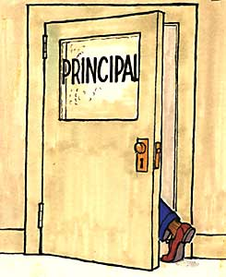
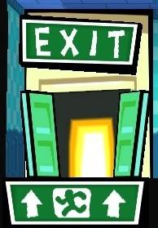
Forms of Punishment
Dismissal from the classroom:
Used for persistent repetition of disorderly conduct
Sending a learner to the principal:
Reserved for serious incidents in which order of the entire madressah is involved
Discipline

Slide 48
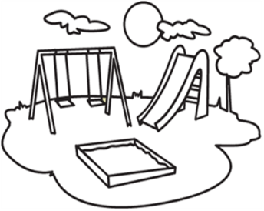


Forms of Punishment
Scolding:
Used rarely
Shouldn't be done in front of the whole class.
Expulsion:
Only extreme cases.
Only used when no other alternative is found.
Depriving child of playtime.
Discipline

Slide 49
When dealing with children, we must always look at the loving example of the prophet (s.a.w)
Teach Allah’s quality of forgiveness before His qualities of punishment and retribution.
This creates confidence in the child, not humiliation.
He (s.a.w) said “He is not one of us who does not show mercy to our little ones”.
He (s.a.w) never once beat a child.
He (s.a.w) taught that the first thing to build in the child is love for Allah and his messenger, not fear.
Discipline

Slide 50
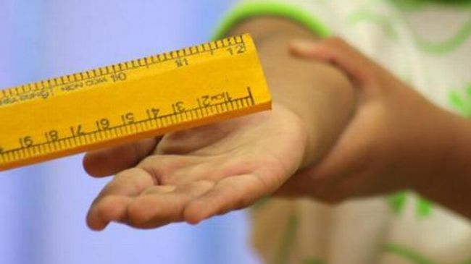
Corporal Punishment
Against the Law.
They gain status amongst peers. Marks shown as a sign of pride.
Creates resentment.
No link between punishment and “the supposed” wayward behavior.
It leads to “dropping out”
Discipline

Slide 51

How to manage tantrums
These are usually displayed by very young learners.
At the beginning of each academic year it is advisable to draw up guidelines governing discipline. The idea is to:
  Make them aware
  Responsibilities
  Rules
  Punishment /Disciplinary action
Discipline
Notes:
Liaten to your child... Continued from previous slide:
“Verily, Allah is with the patient.” [2:153],
“A muslim is a brother another Muslim.
These principles should be applied in conversations with children teenagers as well as adults. It is probably even more important with young people because we are setting an example for them. What do we want our children to learn? We cannot expect kindness and respect from our children if we are not being kind and respectful toward them.
Avoiding Contention
The Prophet, sallallaahu alayhe wa sallam,said,
“If a man gives up contention when he is in the wrong, a house will be built for him within the Garden of Paradise; but if a man gives up contention, even when he is in the right, a house will be built for him in the loftiest part of the Garden.” (Termithi)
Let us all work to improve our style of communication and our relationships with each other. When our children feel that their teachers understand them and are willing to listen to them, they will open up their hearts and trust will develop. Effective teaching and discipline cannot be implemented without a certain level of trust, understanding, and mutual respect.
If you are concerned about your children in an environment and it is affecting the way you interact with them, the best you can do is teach and advise them, give them responsibility, trust them, and let them know that you care for them. We can then make du’a and rely upon Allah’s Grace and Assistance.
This is our best weapon in a world hostile to islam. May Allah help each of us to strengthen the ties that bind us together as a ummah and bring happiness and contentment to our classroom?
PRACTICAL TIPS:
Set aside some time each day to talk to the children. If you have time, try to give each child his/her individual time.
Read books to your children about Islam that pertain to relationships with others and stories about the prophet, sallallaahu alayhe wa sallam, and the companions, radiallaahu anhum. These will provide you with the necessary guidelines and inspiration.
Obtain advice from other teachers when needed, especially those who have experience. This may save time and avoid undue hardships and pain.

Slide 52
Most extreme measure!
Isolation for disruptive learning is uncomfortable - it’s meant to be.
Remember that learners my live up to the label of being disruptive and they become more defiant because they are rejected. This could later lead on to criminal behaviour.
Expulsion
Discipline
Notes:
Expulsion – most extreme measure. Only to be resorted to where no alternative is found
There is an alternative to expulsion.
Isolation for disruptive learning is uncomfortable - it’s meant to be.
It is a consequence for inappropriate behaviour.
Remember that learners my live up to the label of being disruptive and they become more defiant because they are rejected. This could later lead on to criminal behaviour.
The young person graduates to a group that provides a sense of belonging and gangs are only too willing to do their anti-social work.
Remember that 20% of unruly learners disrupt education for 80% that want to learn.
20% takes up 80% of the teachers energy giving very little time to do what the teacher wants to do.

Slide 53
Expulsion
Remember that 20% of unruly learners disrupt education for 80% that want to learn.
20% takes up 80% of the teachers energy giving very little time to do what the teacher wants to do.
Discipline
Notes:
Expulsion – most extreme measure. Only to be resorted to where no alternative is found
There is an alternative to expulsion.
Isolation for disruptive learning is uncomfortable - it’s meant to be.
It is a consequence for inappropriate behaviour.
Remember that learners my live up to the label of being disruptive and they become more defiant because they are rejected. This could later lead on to criminal behaviour.
The young person graduates to a group that provides a sense of belonging and gangs are only too willing to do their anti-social work.
Remember that 20% of unruly learners disrupt education for 80% that want to learn.
20% takes up 80% of the teachers energy giving very little time to do what the teacher wants to do.

Slide 54
The Responsibility of the Educator is:
To be punctual and reliable
To create routine regularity in the classroom
To prevent problems by proper planning and preparation
To provide high levels of supervision
To set clear limits to behaviour
Discipline

Slide 55
To be firm and manage the behaviour of his/her class
To be fair and just and with rules that can be enforced
To be respectful of the learners
Not to use learners to run personal errands
Not to humiliate learners
To make an effort to know and understand the learners
Discipline

Slide 56
When you think of Discipline…
What are the first thoughts the come to mind?
Remember we asked you this in the beginning?
Well now, think about this...
Look through your notes now to determine how much you’ve learnt?
Is your outlook the same? If not, how has it changed?
Discipline

Slide 57
Some good reasons to remain patient
1. You will have hope in entering Paradise
According to hadith, The Prophet (saw) states that Allah has said: "O son of Adam! If you remain patient restraining yourself and expecting my reward at the initial shock, I will not be happy without rewarding you with Jannah."
2. It can be an indicator that you are among the righteous:
According to hadith, The Prophet (saw) said: "Wondrous are the believer's affairs. For him there is good in all his affairs, and this is true only for a believer. If he encounters something troubling, he remains steadfast with patience, and that is good for him. If he experiences something pleasing, he thanks Allah, and that is good for him." (Muslim)
3. It is one of the greatest gifts you can be given:
According to hadith, the Prophet (saw) said "Whoever practices patience, Allah, Glory be to Him the Most High, gives him patience. And no one can be given anything better or more far-reaching (comprehensive) than patience." (Bukhari, Muslim)
Discipline

